Slide 1
Title: BoxFit – Web Application Conceptual Design
Student Name: Fernando Silva
Matriculation Number: U14087143
Course: DLBCSPJWD01 – Project Java and Web Development
Submission Phase: Phase 1 – Conception
Filename: Silva_Fernando_U14087143 _PJWD _P1_S.pptx

Slide 2

Introducing BoxFit
BoxFit is a private, web-based social platform built for a dynamic boxing gym community in Hamburg.
Designed to connect gym members beyond training sessions, promoting motivation, accountability, and celebration of progress.
Members can post training updates, photos, videos, comment on others' posts, and follow each other.
Unlike public platforms, BoxFit offers a members-only, secure space to build an engaged and supportive gym community.

Slide 3

Audience & User Value
Target Users:
People of all ages looking to improve their fitness
Amateur and professional boxers
General fitness enthusiasts and gym-goers
Individuals starting their training journey or returning to fitness
Coaches, personal trainers, and group instructors
Anyone seeking a supportive, community-based training environment
User Benefits:
A motivating, interactive digital extension of the physical gym
Easy content sharing and peer recognition
Exclusive, private environment free from external distractions
Builds team spirit, consistency, and community support outside of training hours

Slide 4
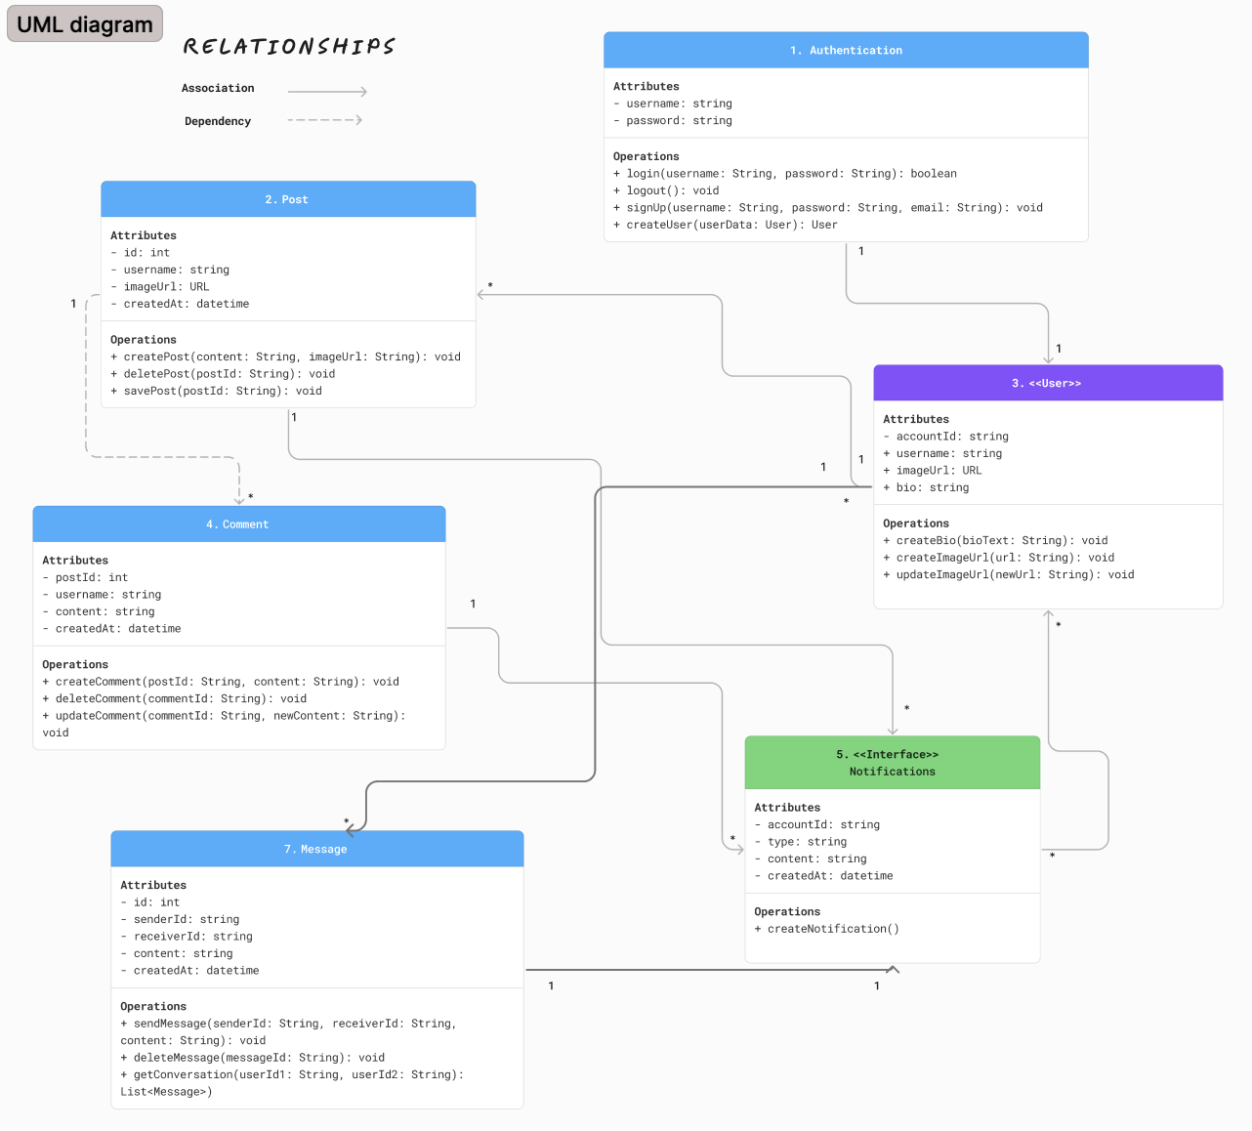
Technology Stack & System Design
Frontend:
ReactJS for the user interface.
React Query for state management.
Backend:
MongoDB handles authentication, database, and storage.
Infrastructure Flow:
React interacts directly with MongoDB backend.
Frontend logic is fully integrated with MongoDB backend.
Ensures responsive design and seamless user interactions

Slide 5

Key Components & Features
Authentication: Secure member login using Appwrite’s auth service.
Posts: Members can share text, media, and updates with the community.
Comments & Likes: Social interactions to foster engagement.
User Profiles: Display personal training progress and posts.
Notifications: Alert users to likes, comments, or new followers.
Messaging: Direct messaging between members to enhance interaction.
All features tightly integrated with MongoDB collections and React front-end components.

Slide 6

Conceptual Summary & Next Steps
BoxFit was conceptualised to provide a secure, engaging social platform tailored to a boxing gym.
Technologies were selected for speed, scalability, and ease of development.
Design ensures mobile responsiveness and growth potential for future features.
Next Steps:
Begin development phase.
Prepare screencast demo and code integration via GitHub.

